Slide 1
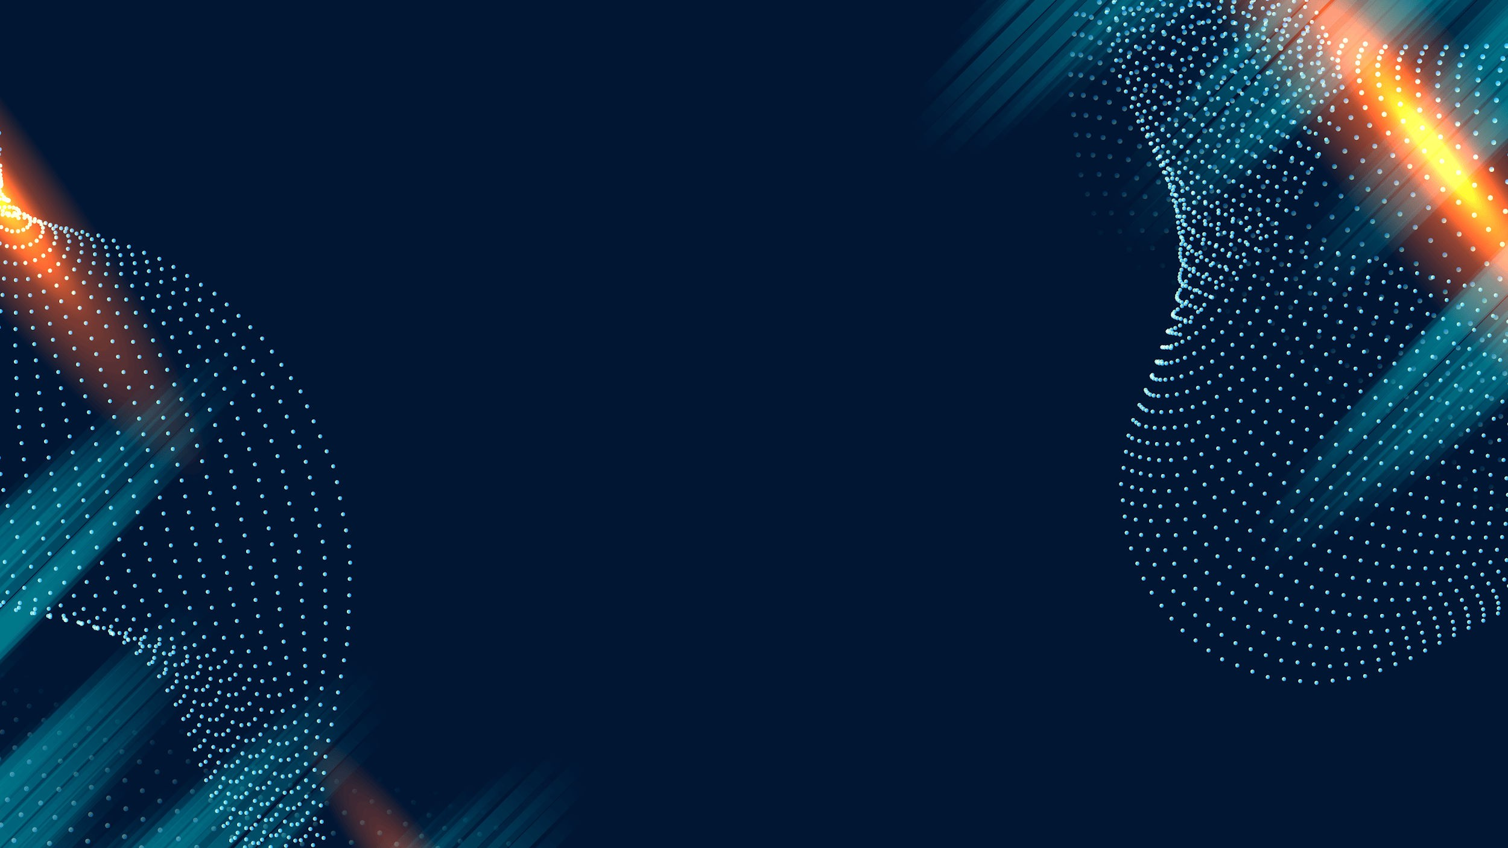
Between Neurons and Circuits: Unraveling the Mystique of Mind vs. Machine

Slide 2

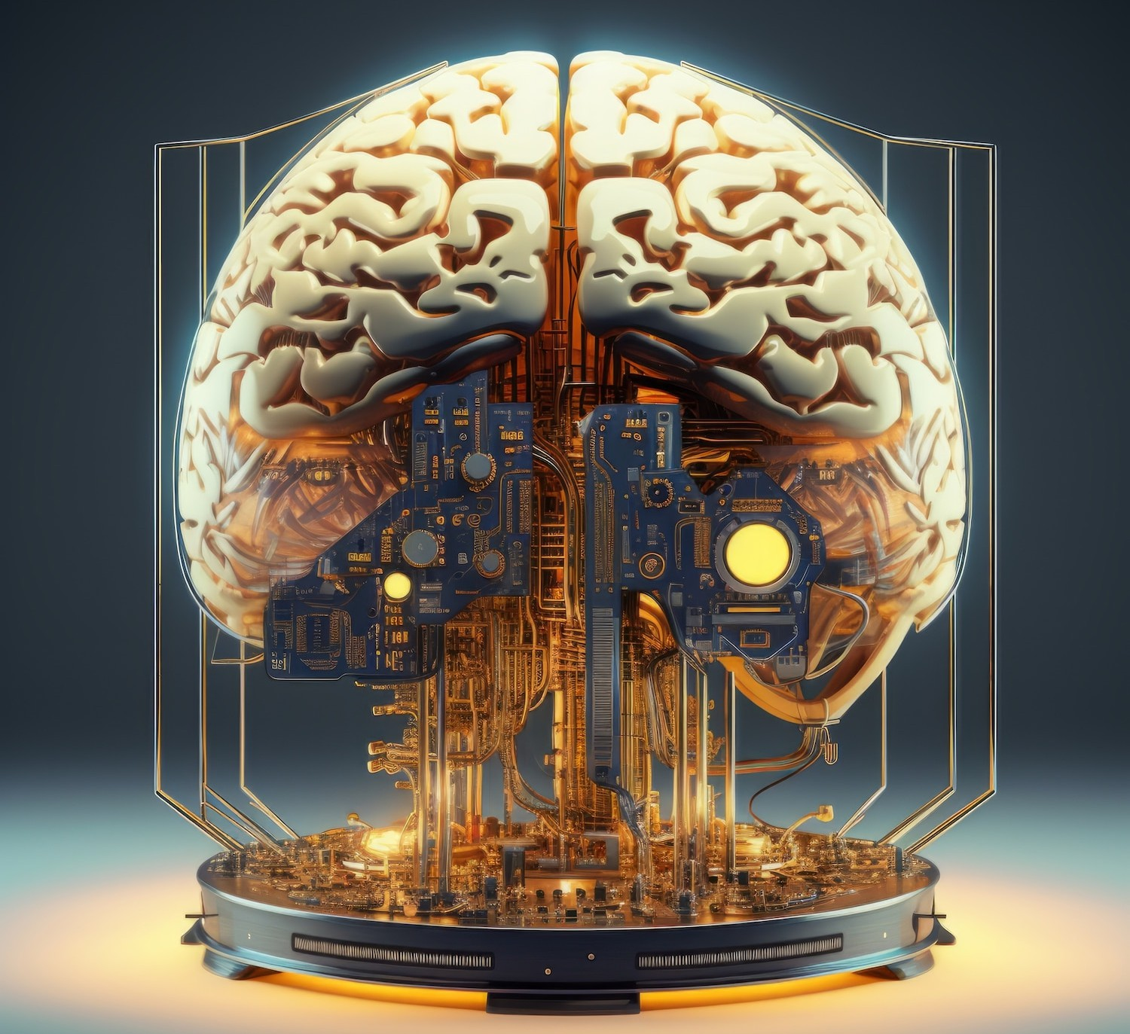
Introduction to Mind vs. Machine
Exploring the intricate relationship between neurons and circuits, this presentation delves into the fascinating world of artiﬁcial intelligence and human cognition. We will uncover how these two realms interact and inﬂuence each other, shaping our understanding of consciousness and intelligence.

Slide 3
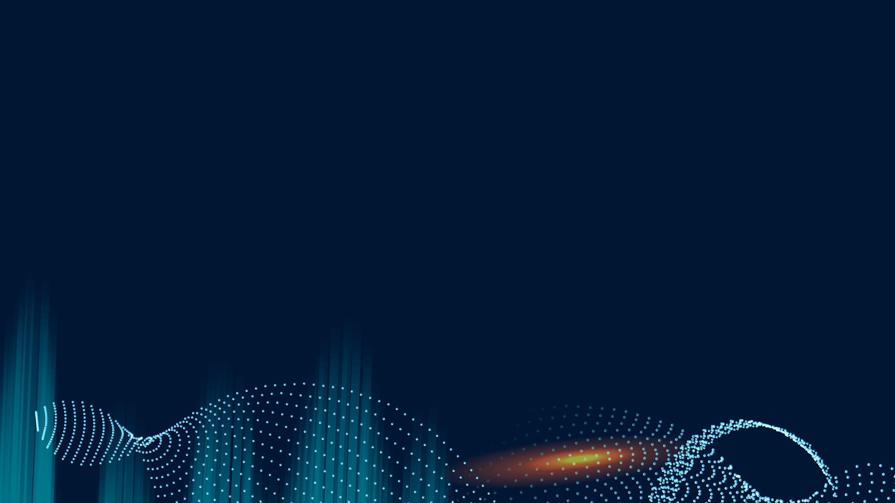
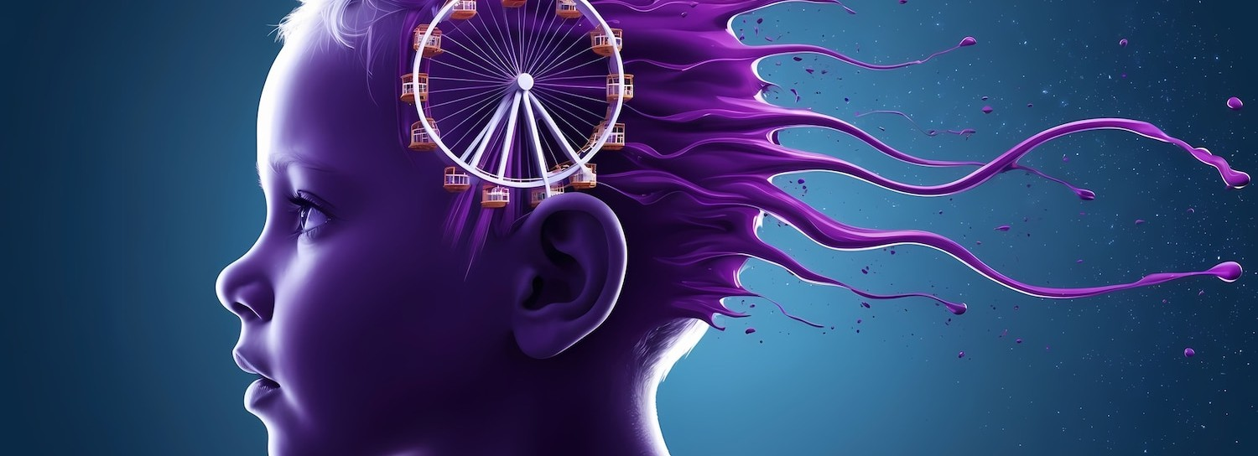
Neurons: The Building Blocks
Neurons are the fundamental units of the brain, responsible for transmitting information through electrical and chemical signals. Understanding their structure and function is crucial to grasp how they contribute to complex behaviors and cognitive processes.

Slide 4

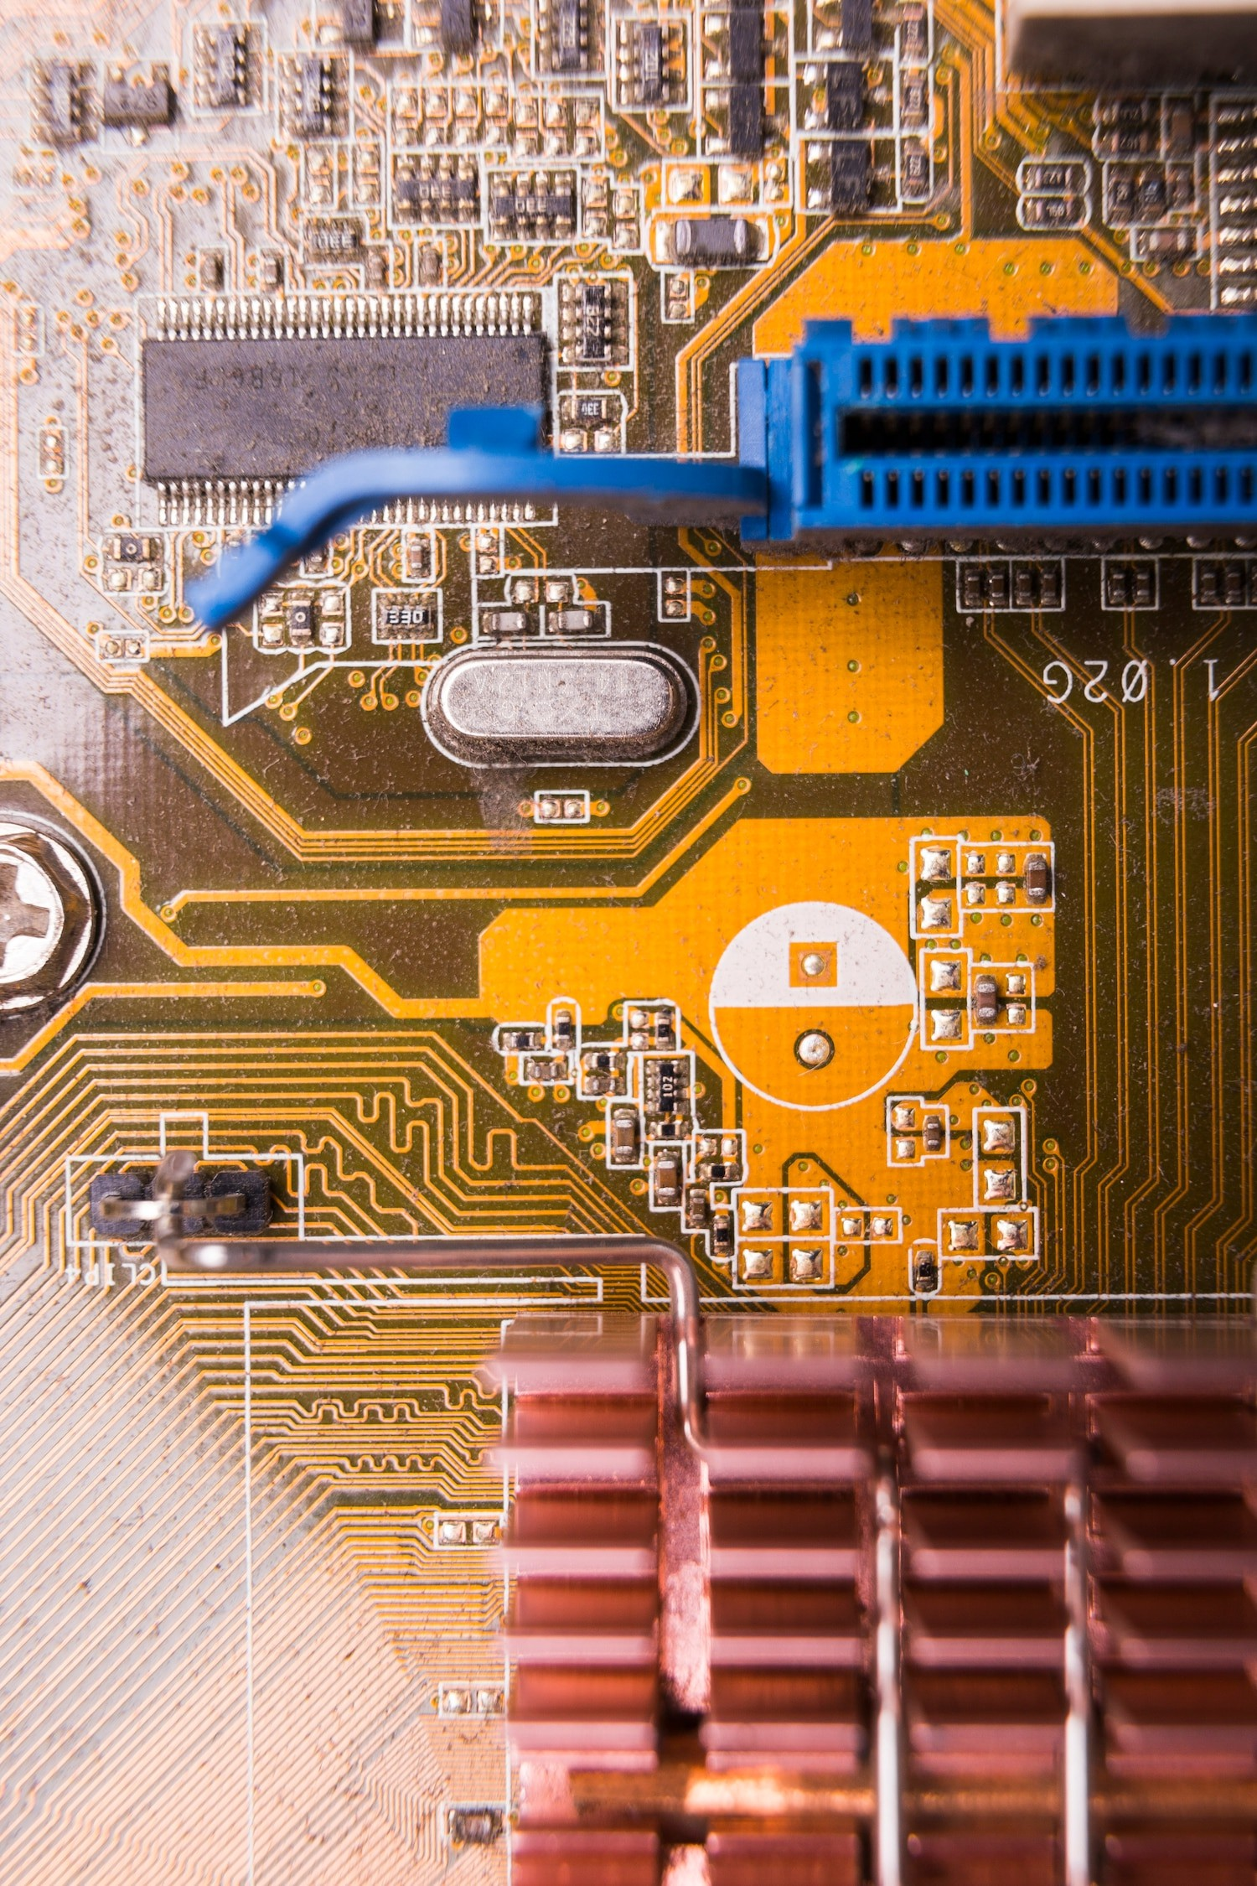
Circuits: The Engine of Machines
Circuits are the backbone of machines, enabling them to process information and perform tasks. By mimicking the neural networks of the brain, engineers create systems that can learn and adapt, blurring the line between human and machine intelligence.

Slide 5
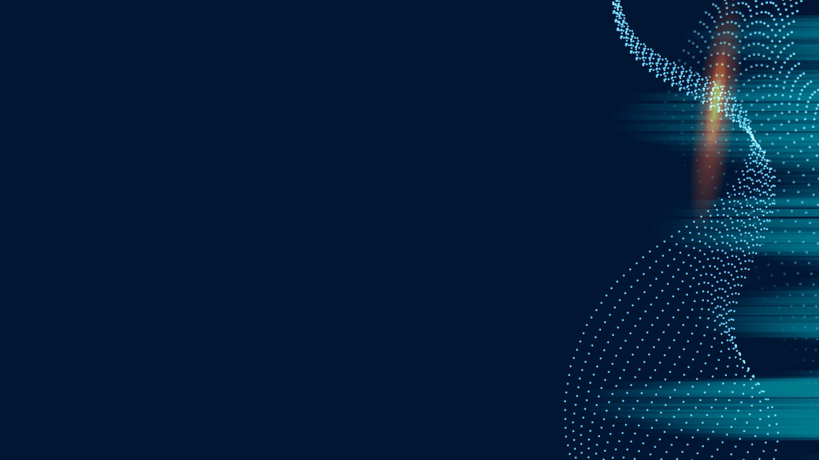
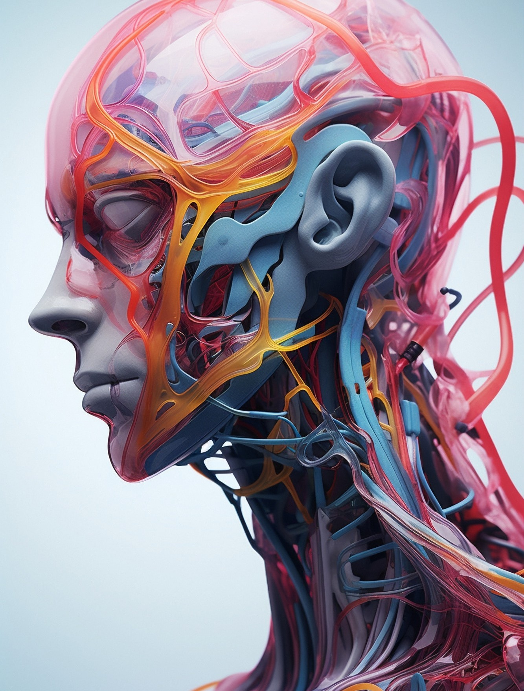
The Brain's Complexity
The human brain is an incredibly complex organ, containing approximately 86 billion neurons. Its intricate network allows for advanced functions such as reasoning, emotion, and creativity, setting it apart from artiﬁcial systems.

Slide 6
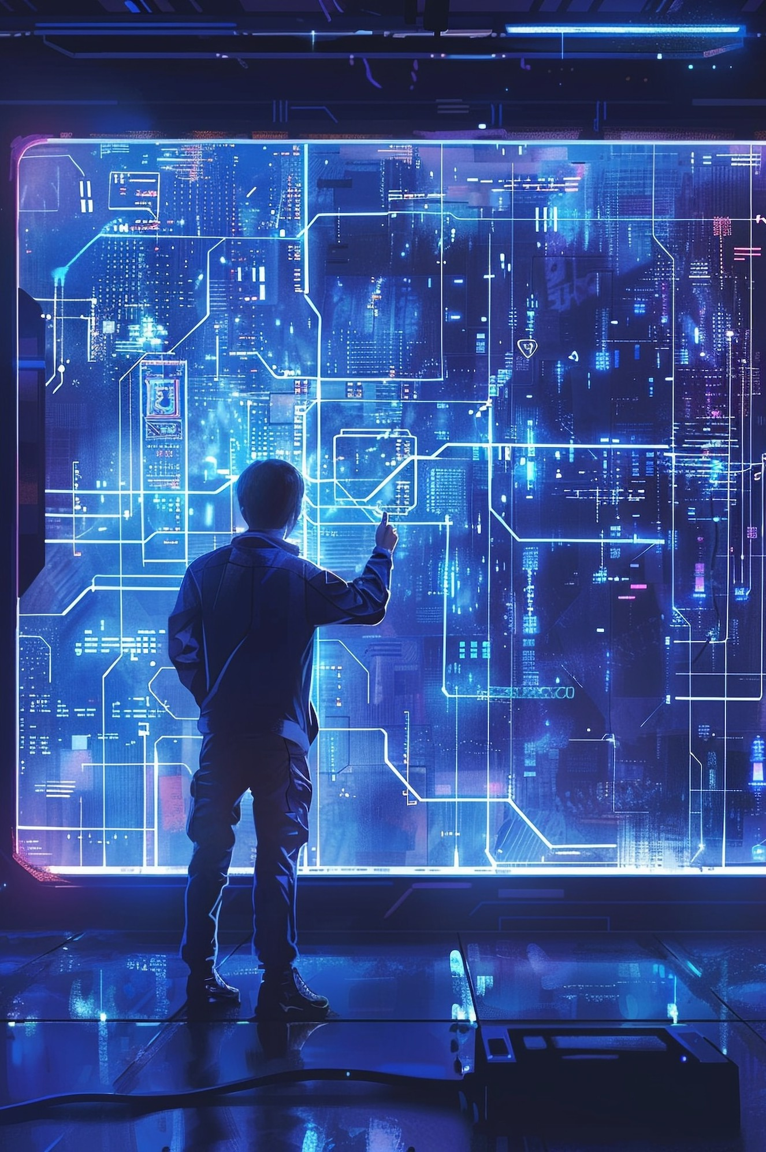
Machines Learning from Neurons
Machine learning algorithms are inspired by the way neurons interact. By analyzing vast amounts of data, these algorithms can identify patterns and make predictions, leading to advancements in AI technology.

Slide 7
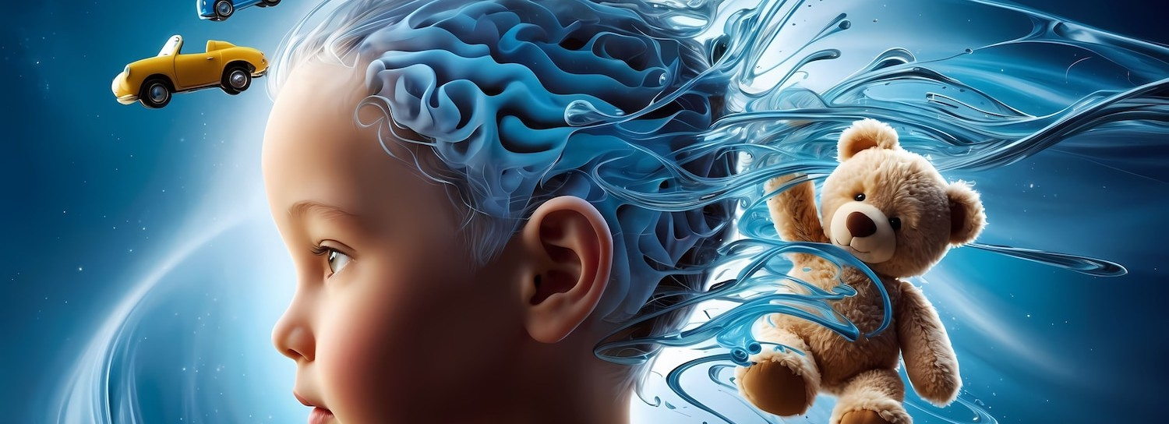
Neuroplasticity and Adaptation
Neuroplasticity refers to the brain's ability to reorganize itself by forming new connections. This concept is crucial for understanding how both human brains and artiﬁcial systems can learn and adapt over time.

Slide 8
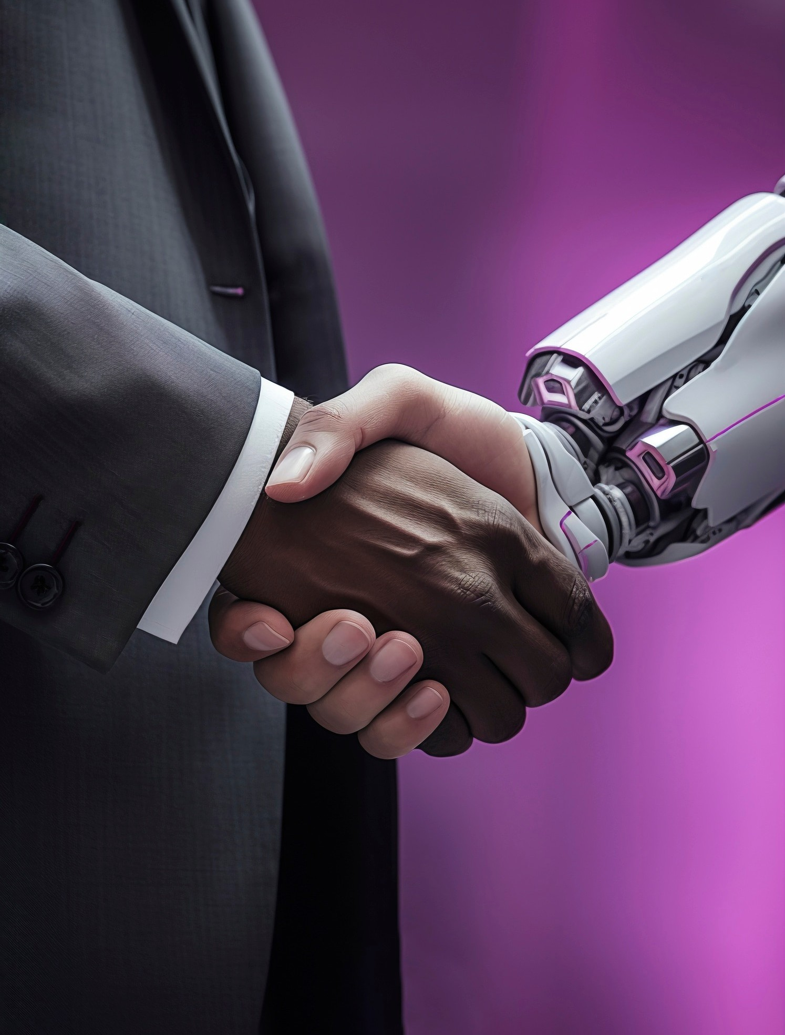
The Ethics of AI
As machines become more intelligent, ethical considerations arise. Questions about autonomy, responsibility, and the essence of consciousness challenge our perceptions of what it means to be human versus machine.

Slide 9
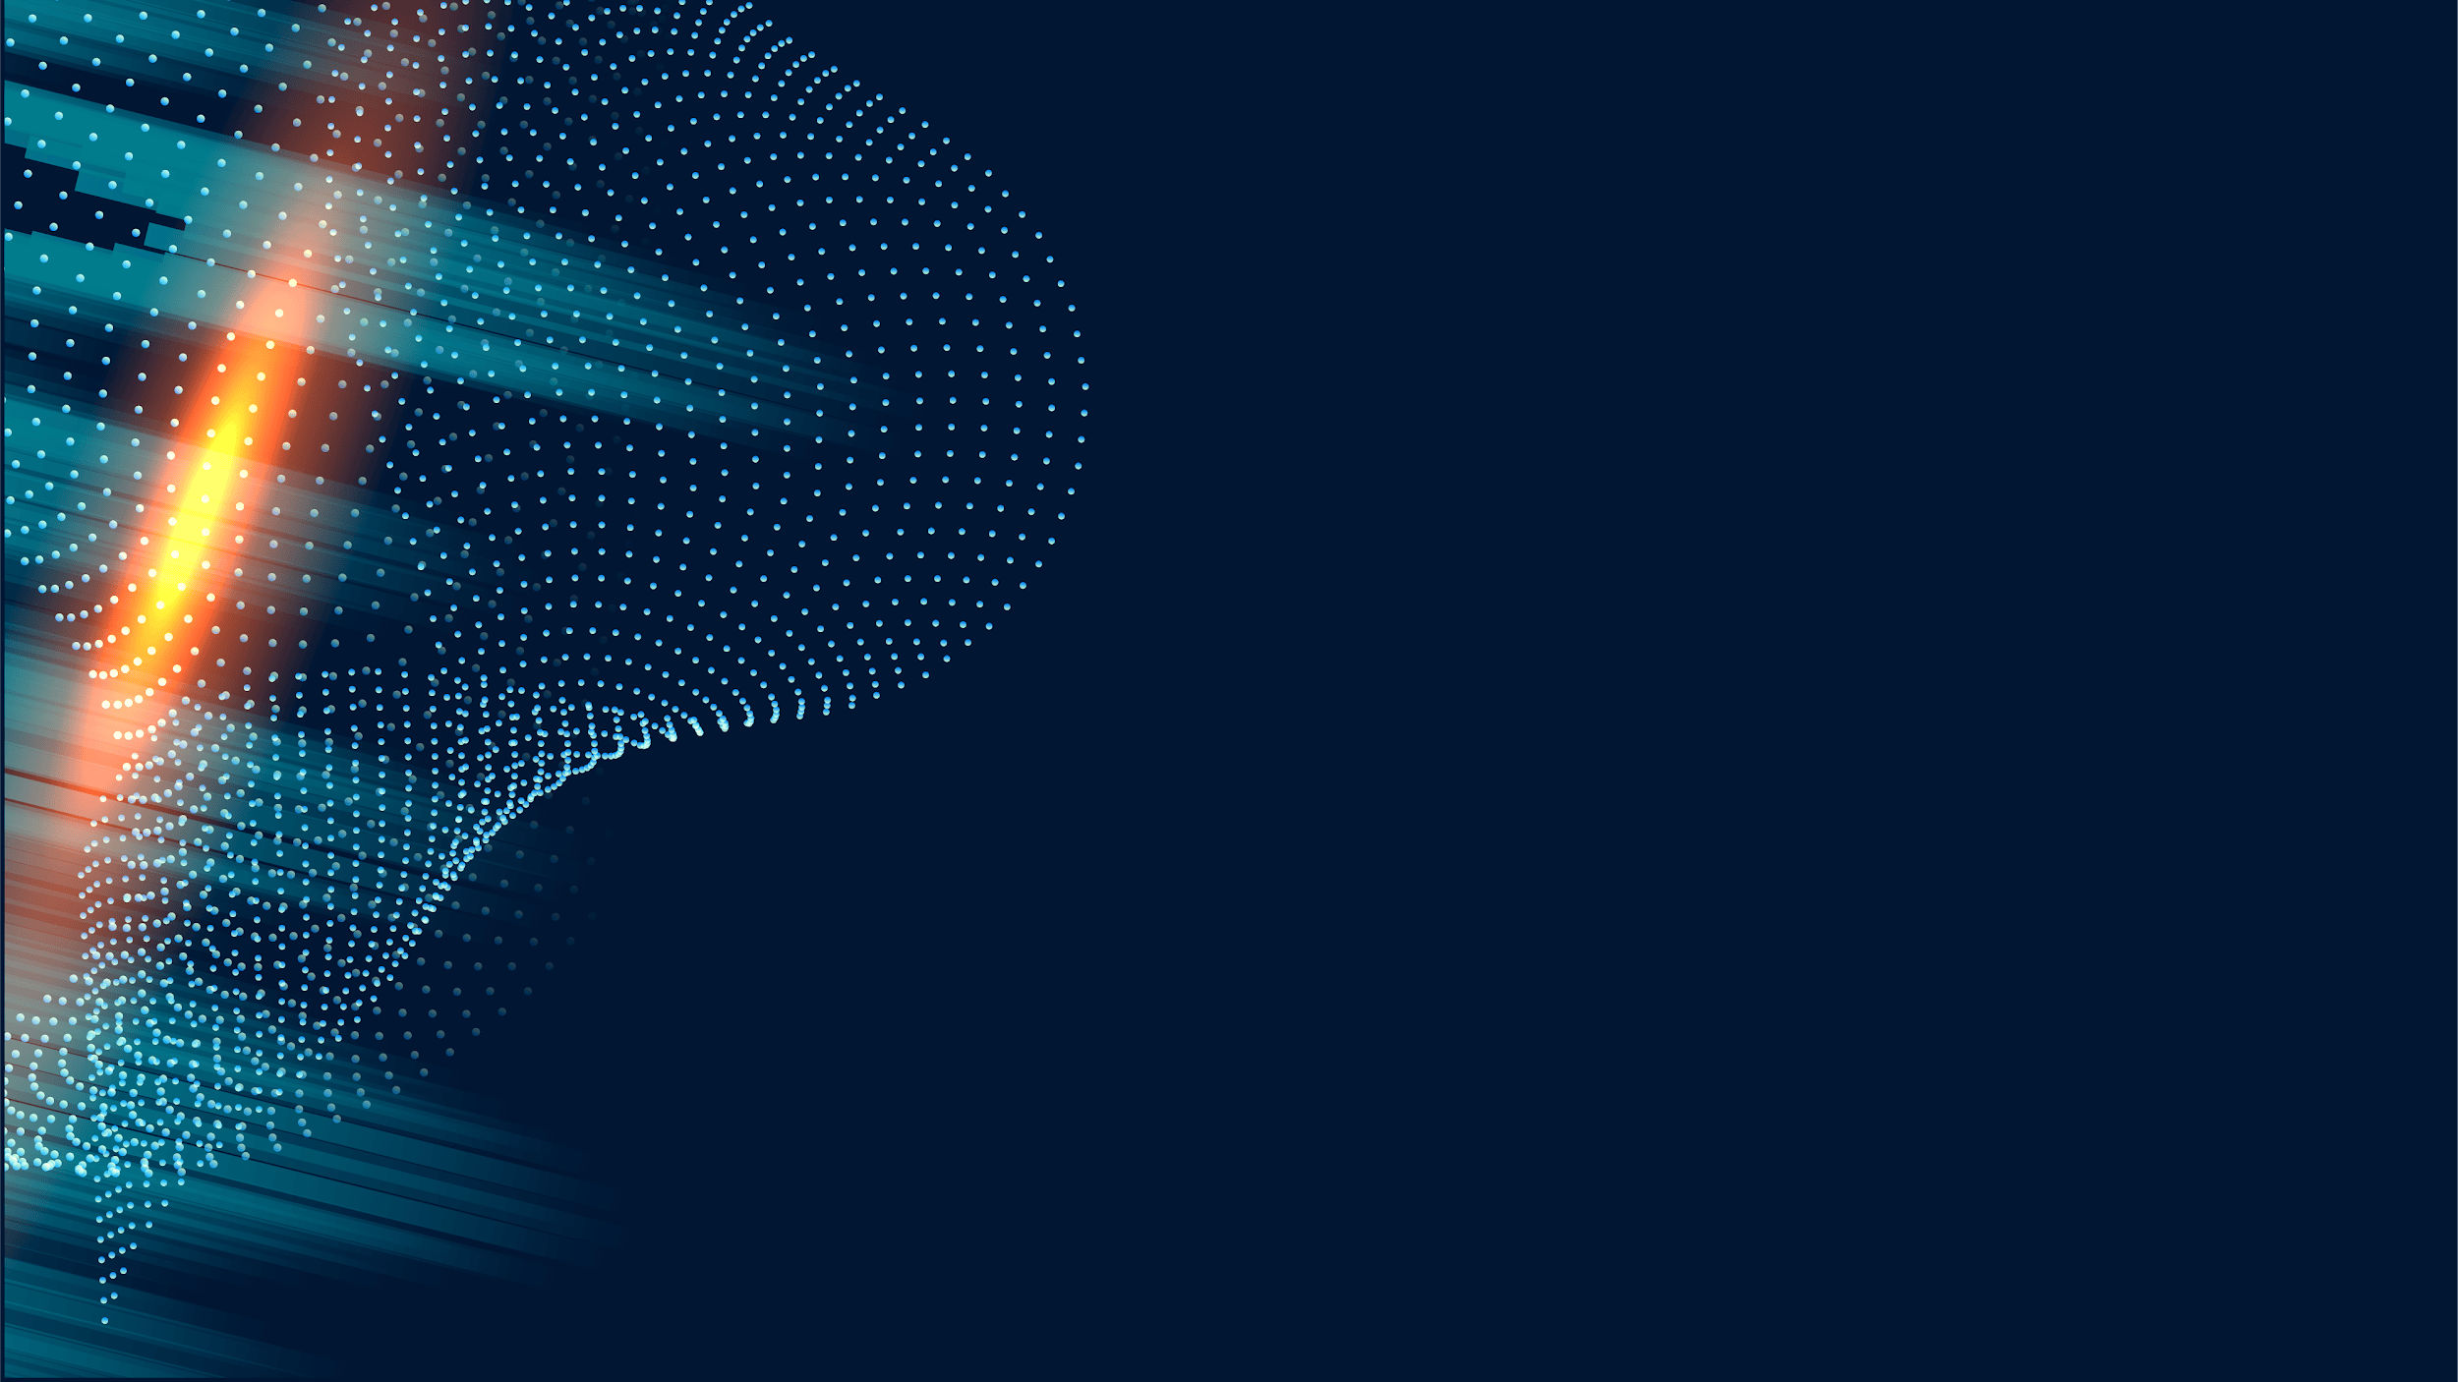
Future of Mind and Machine
The future holds exciting possibilities for the integration of human minds and machines. As technology advances, we may witness a new era where collaboration enhances creativity and problem-solving across various ﬁelds.

Slide 10

Challenges Ahead
Despite the potential, challenges such as bias, privacy, and security must be addressed. Navigating these issues is vital to ensure that the evolution of mind and machine beneﬁts humanity as a whole.

Slide 11
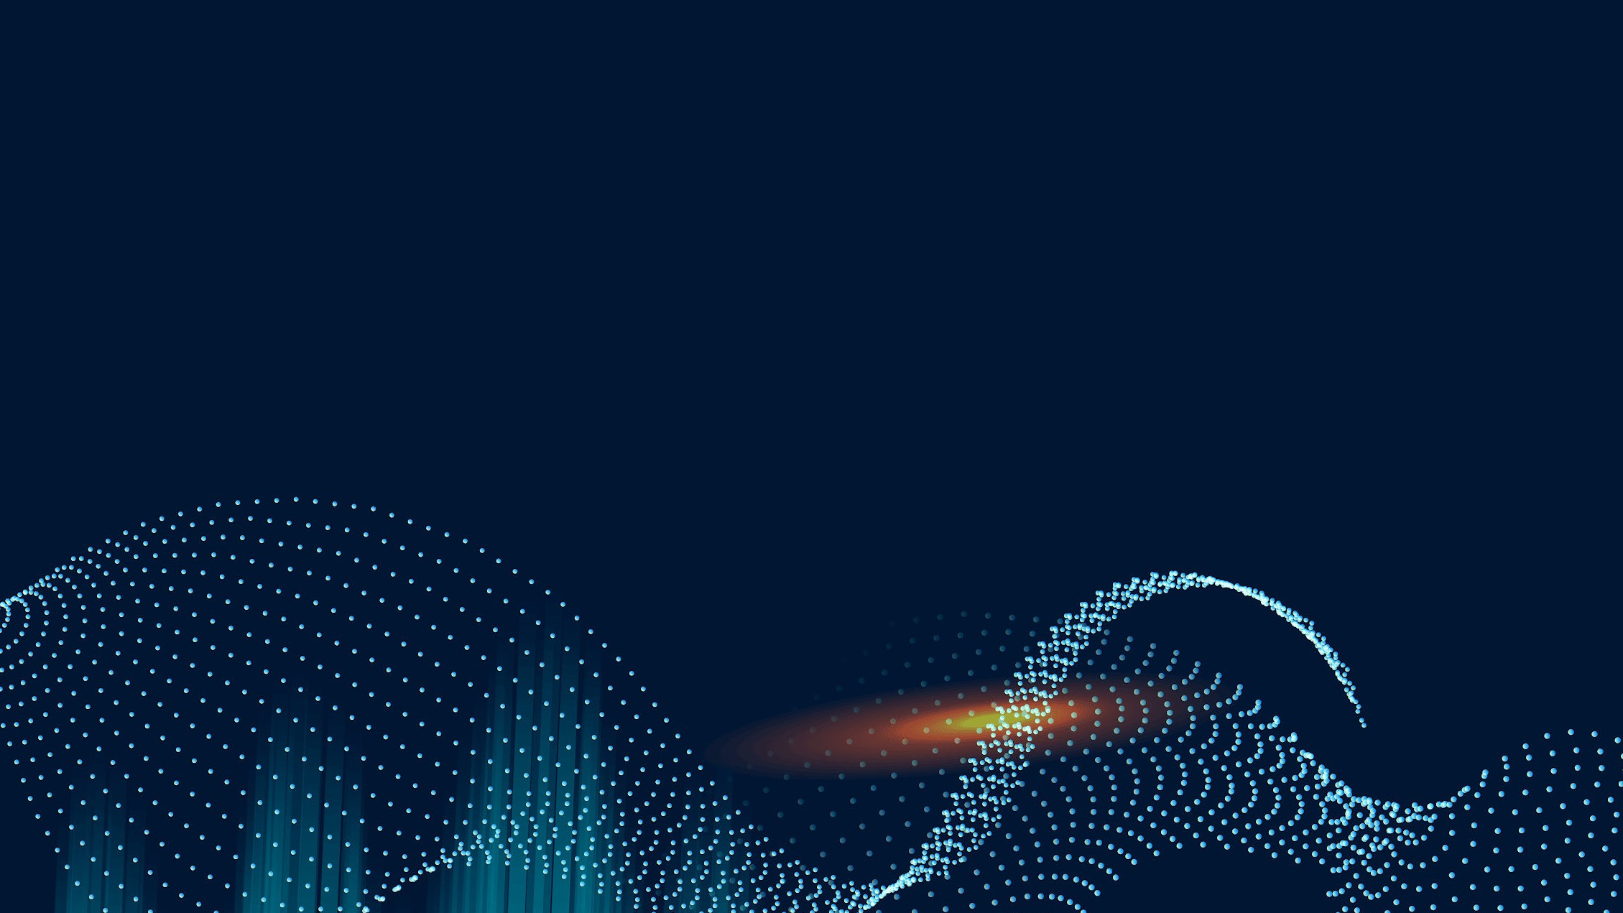
Conclusion: Embracing Duality
In conclusion, understanding the relationship
between neurons and circuits allows us to
embrace the duality of mind and machine. By
exploring their interplay, we can unlock new potentials for innovation and insight into our own consciousness.

Slide 12


Thanks!
Do you have any questions? addyouremail@freepik.com
+91 620 421 838
yourcompany.com

